Slide 1
Effects of Economic Liberalisation in India
SANTHOSHI PISUPATI

Slide 2
Dataset
The dataset used for the analysis:
World Development Indicators Dataset
The dataset contains thousand annual indicators of economic development from hundreds of countries around the world.

Slide 3
Motivation
India is one of the rapidly growing countries - Wikipedia
I want to explore and understand the changes in Indian economy over the past 40 years, how the economic liberalization effected the economic growth. And how this growth contributed to the World GDP per capita.
This analysis showcases the growth a developing country can achieve by reforming the economic policies.

Slide 4
Research Question(s)
In order to understand the economic growth, we define the following research question.
Research question: How economic liberalisation effected the GDP per capita of India and how the country contributed to World GDP per capita from 1960-2014

Slide 5
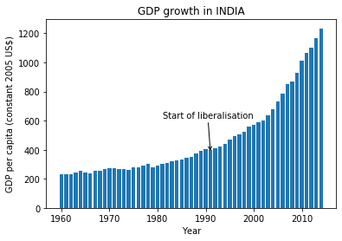
Findings
Economic liberalisation of economic policies started around 1991.
From 1960-1992 i.e. for ~30 years, GDP per capita was between 200-300. After liberalisation, GDP has increased from ~300 to 1300 in the last 25 years.
The impact of liberalisation has predominantly increased GDP per capita after 2000’s.

Slide 6
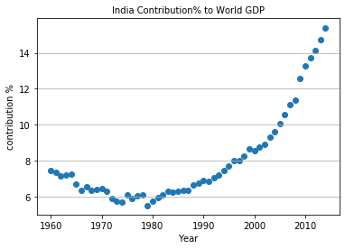
Findings
India contribution to World GDP has increased very rapidly after 2000’s.
i.e. from as low as 6% in 1980s to as high as 15% by 2014.
Economic liberalisation has opened doors to the path of development.
A correlation of 0.8 shows a strong positive relationship between India GDP and World GDP.
np.corrcoef(stage['Value'],world_stage['Value’])
array([[1. , 0.8988201], [0.8988201, 1. ]])

Slide 7
Acknowledgements
Referred some wiki articles regarding economic crisis, liberalisation to construct comprehensive analysis.
I got a positive feedback for my work from my friend.

Slide 8
References
The following are the articles I used to get more clear picture of the topic:
https://en.wikipedia.org/wiki/1991_Indian_economic_crisis
https://en.wikipedia.org/wiki/Economic_liberalisation_in_India

